Slide 1
Introduction to Arduino
A Hsu Foundation Initiative

Slide 2
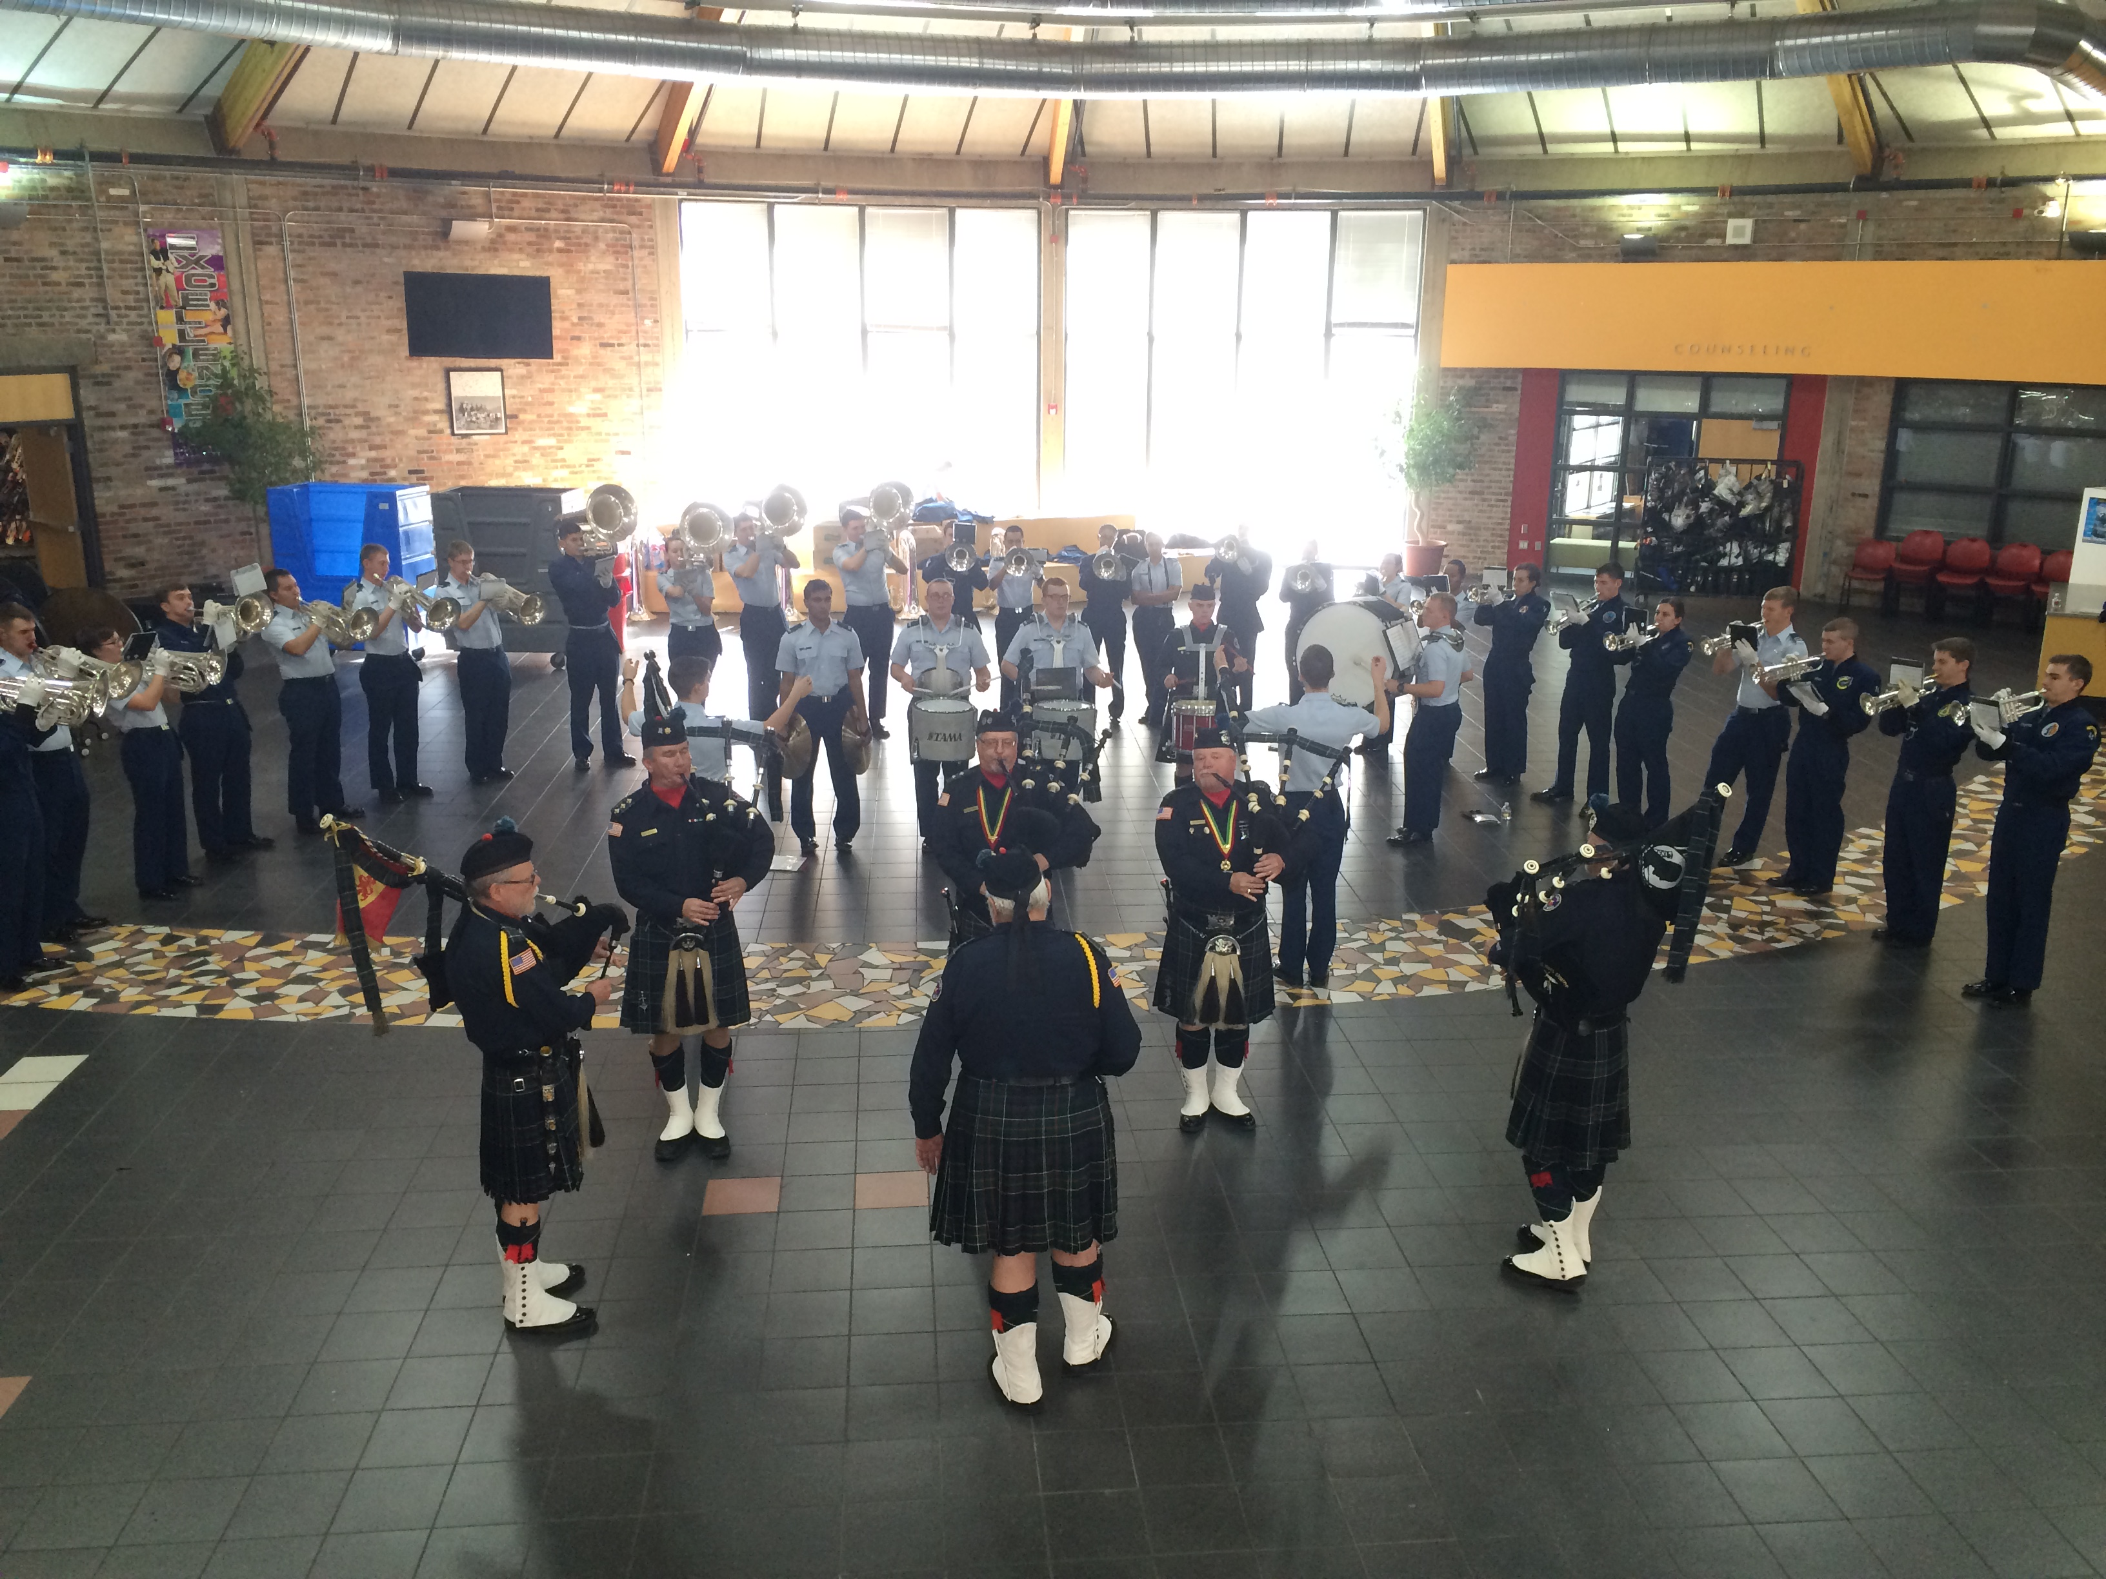
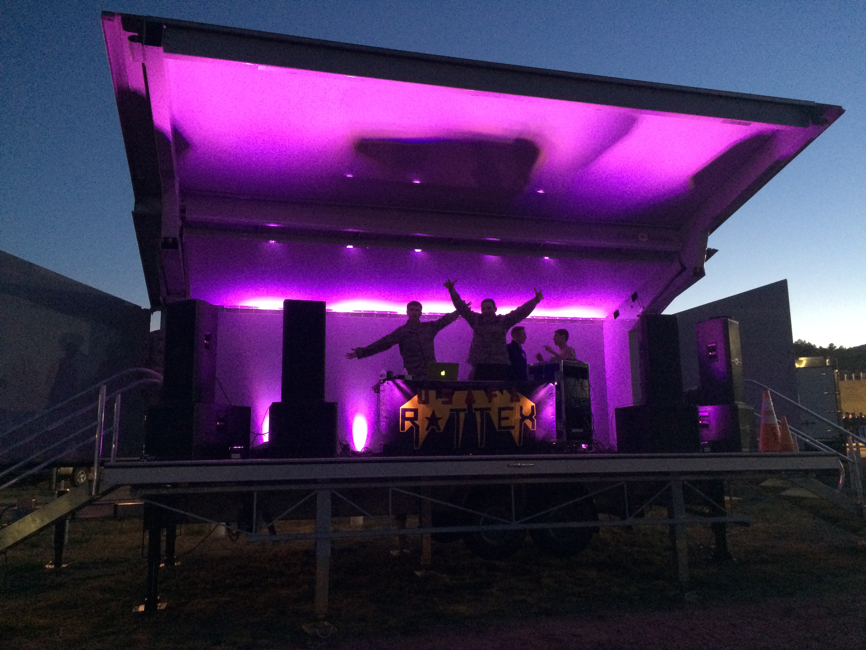
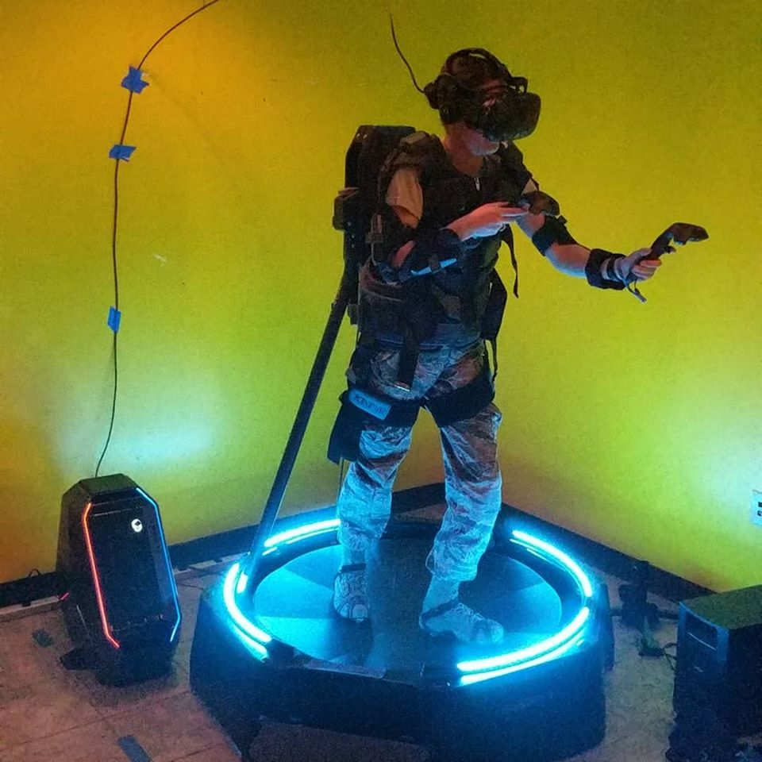

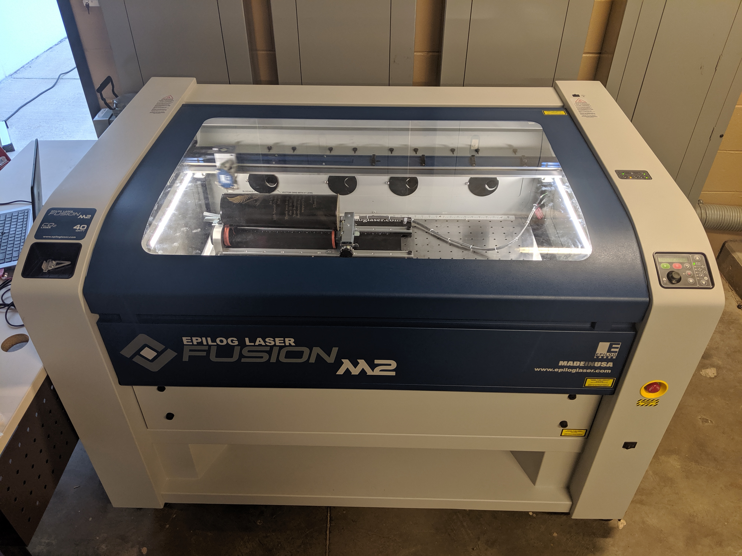
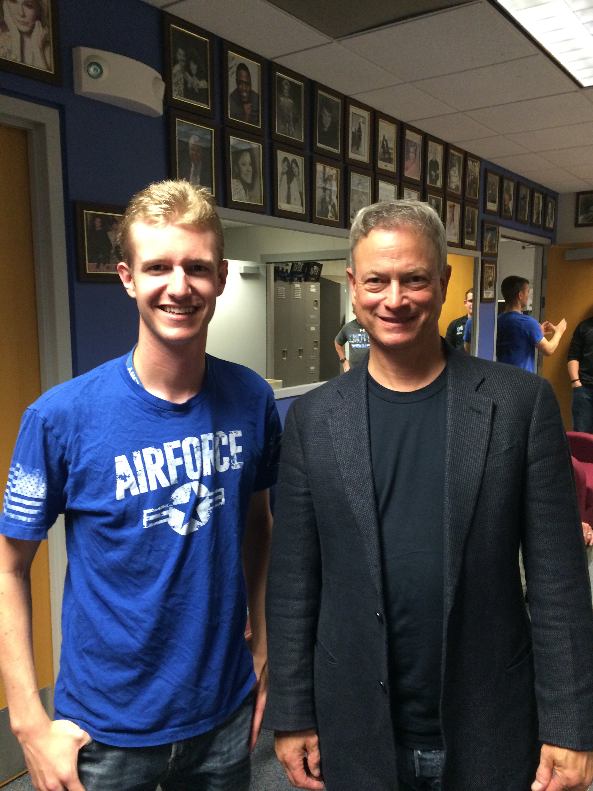


1st Lt Gareth Price
Richmond Hill High School, GA, 2013
BS in Computer Science, USAFA, 2017
17D in the USAF, Programmer at 11SOIS
SCUBA Diving
Sailing
IoT Design and Programming
3D Printing

Slide 3

Introduce Yourself!
Name
School
Grade
Hobbies
Future Job
Fun Fact

Slide 4
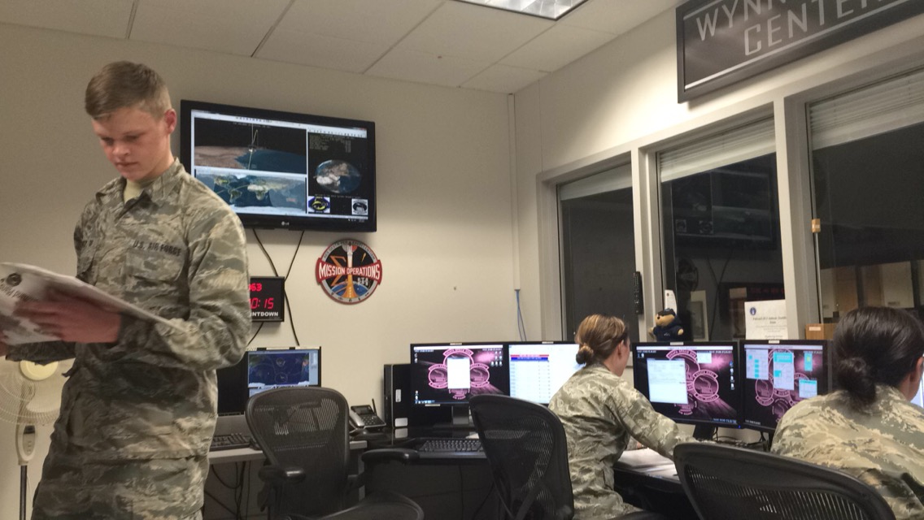
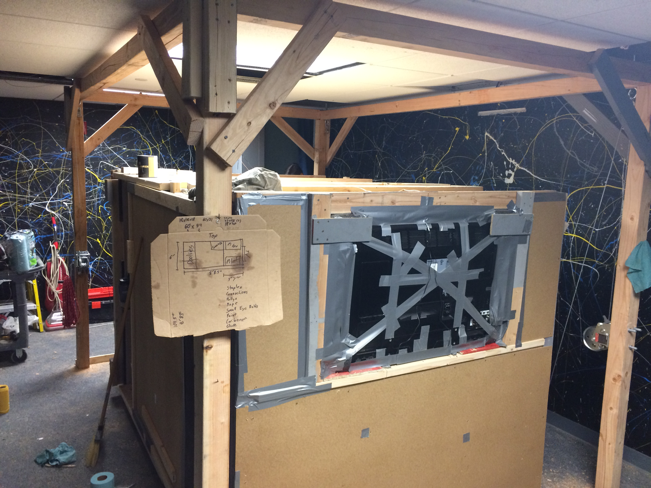
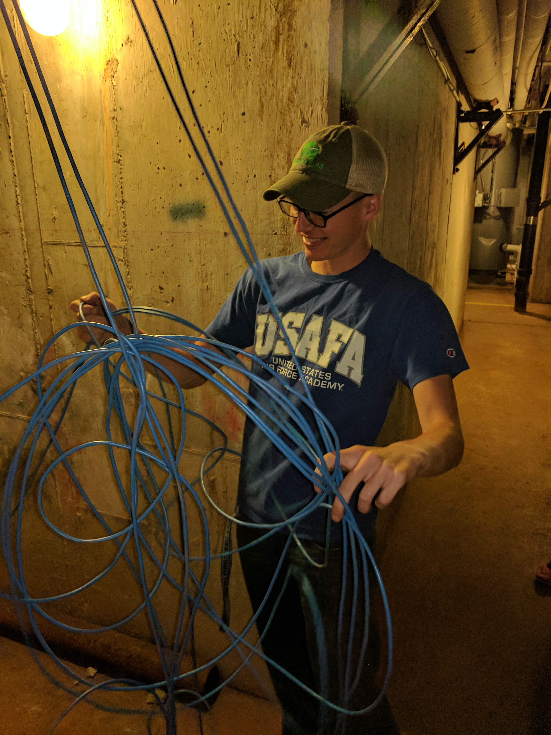
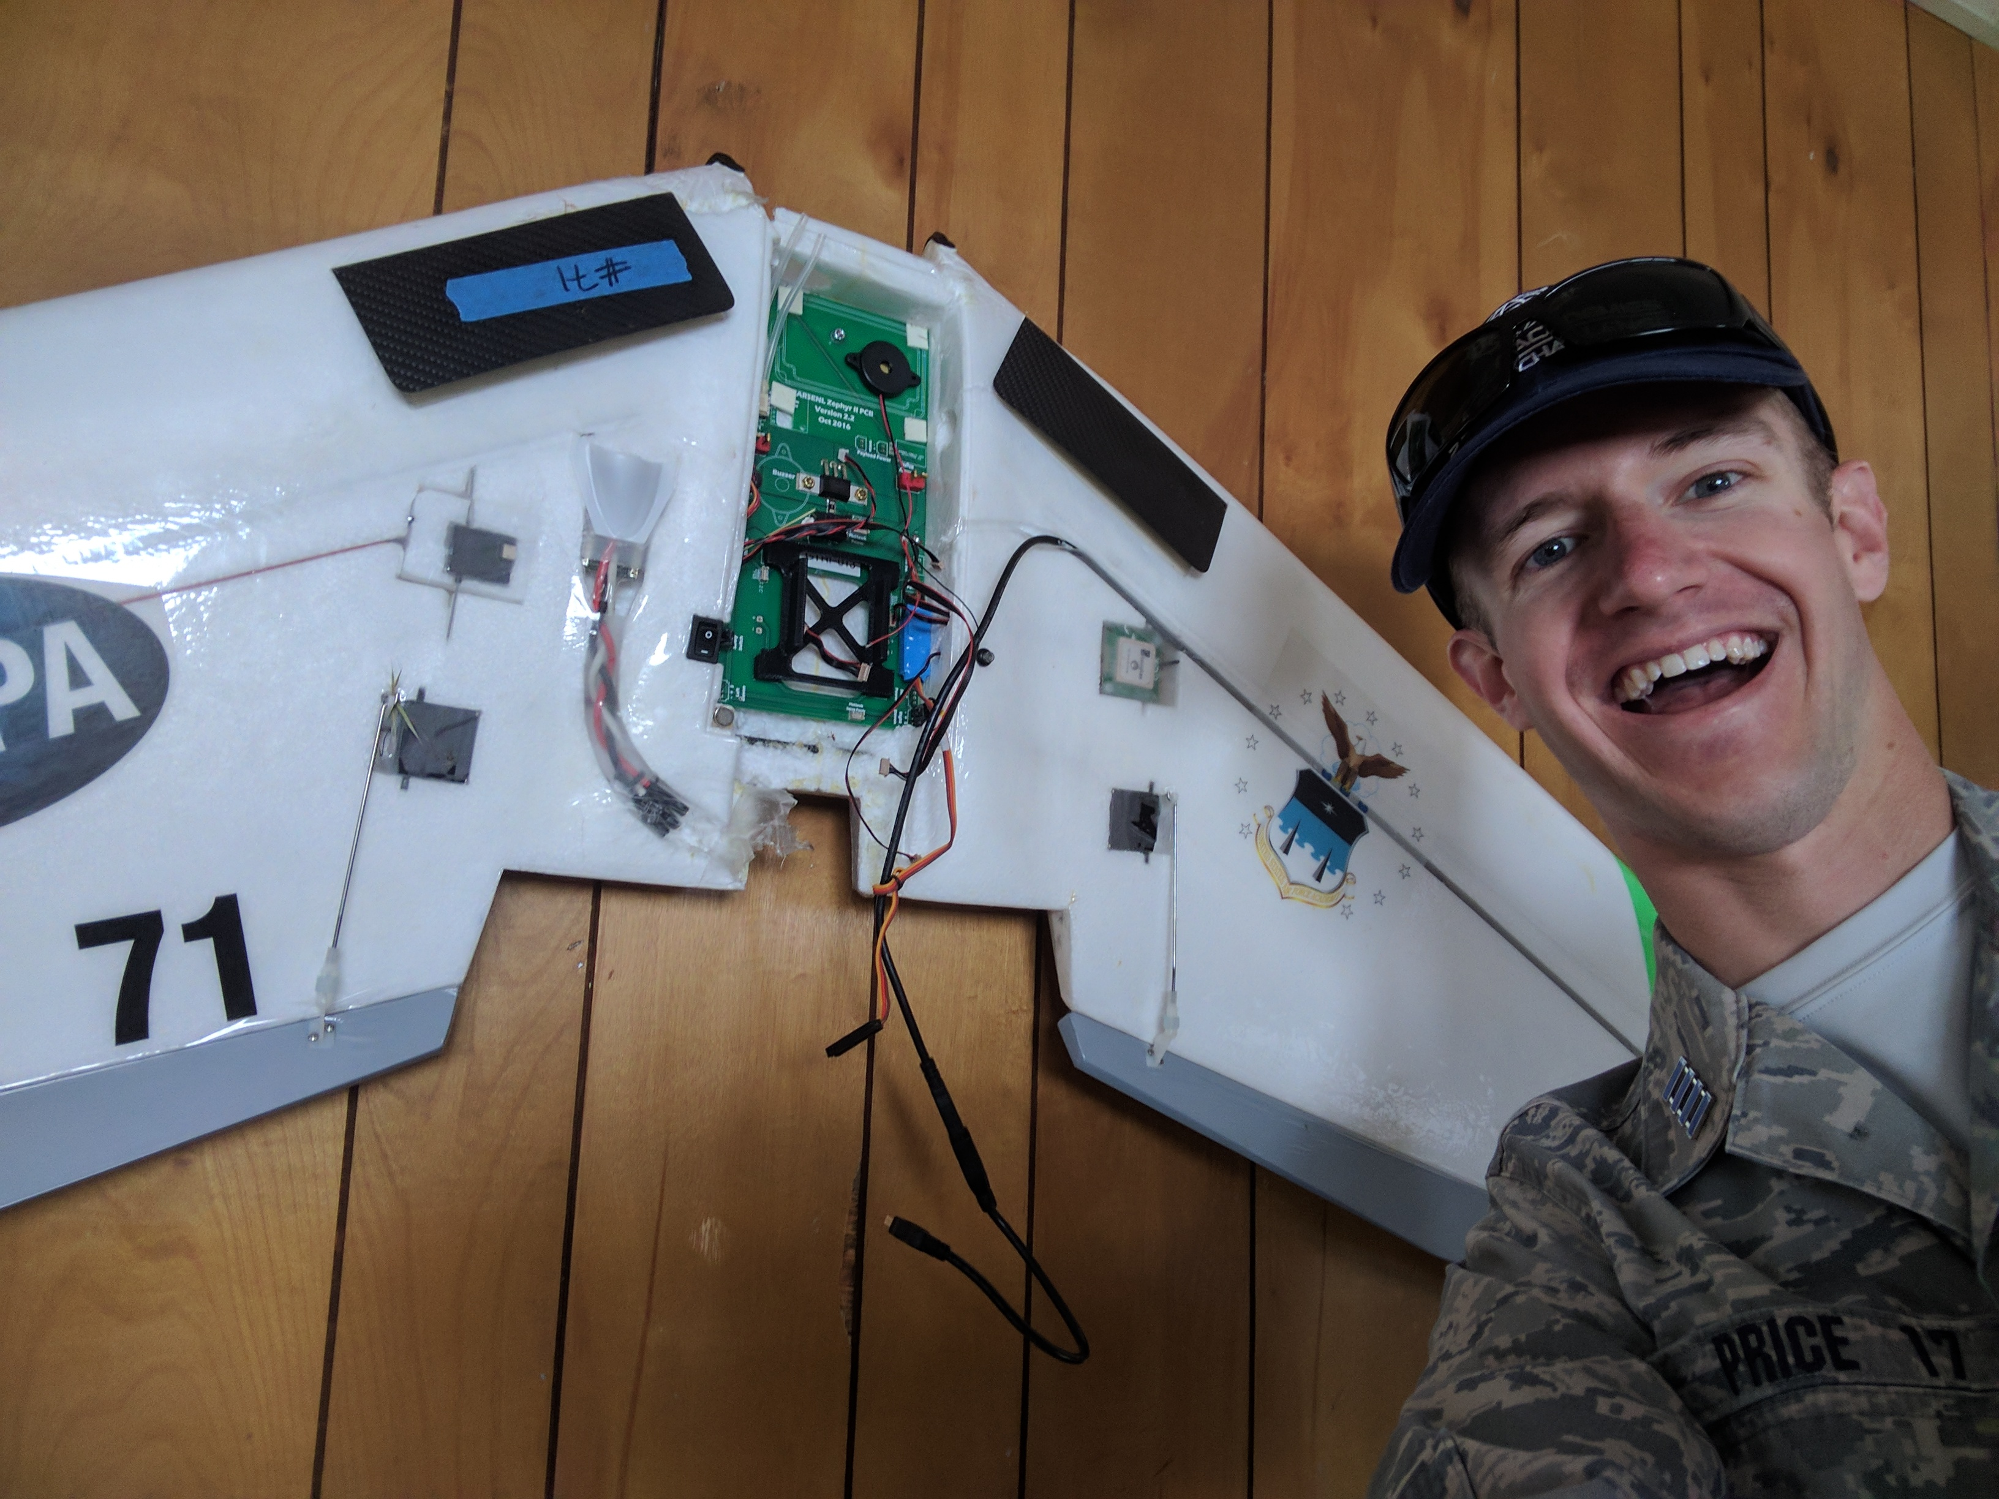
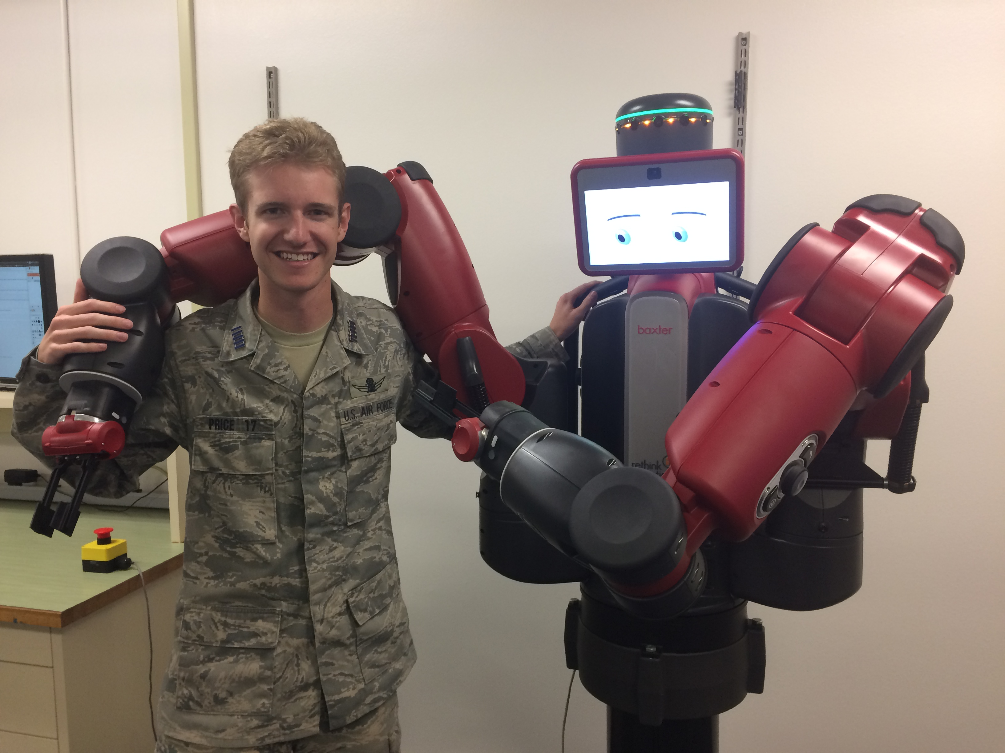

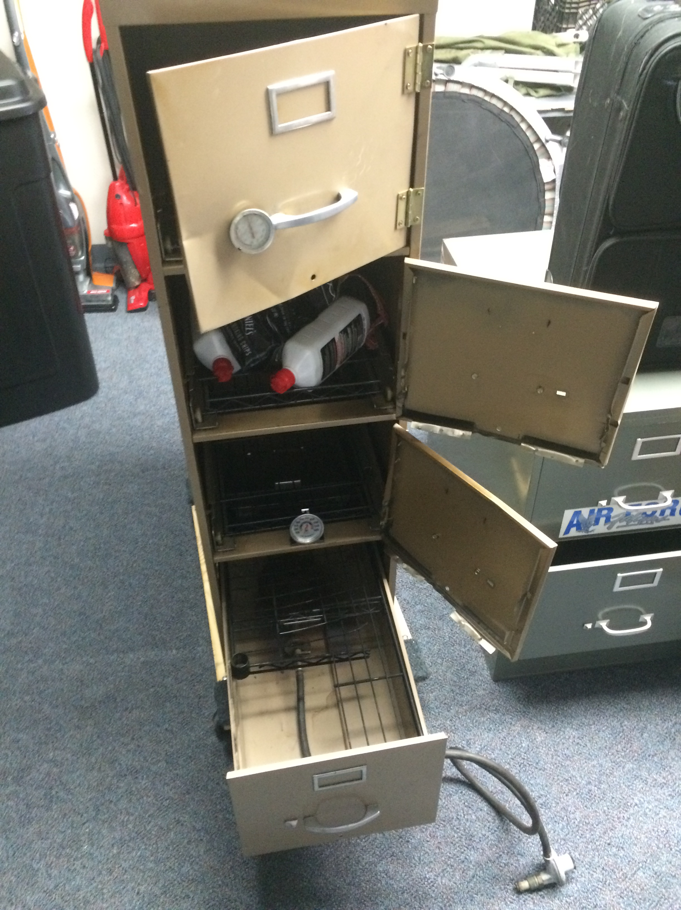
Why Learn Arduino?
It’s a gateway to engineering!

Slide 5
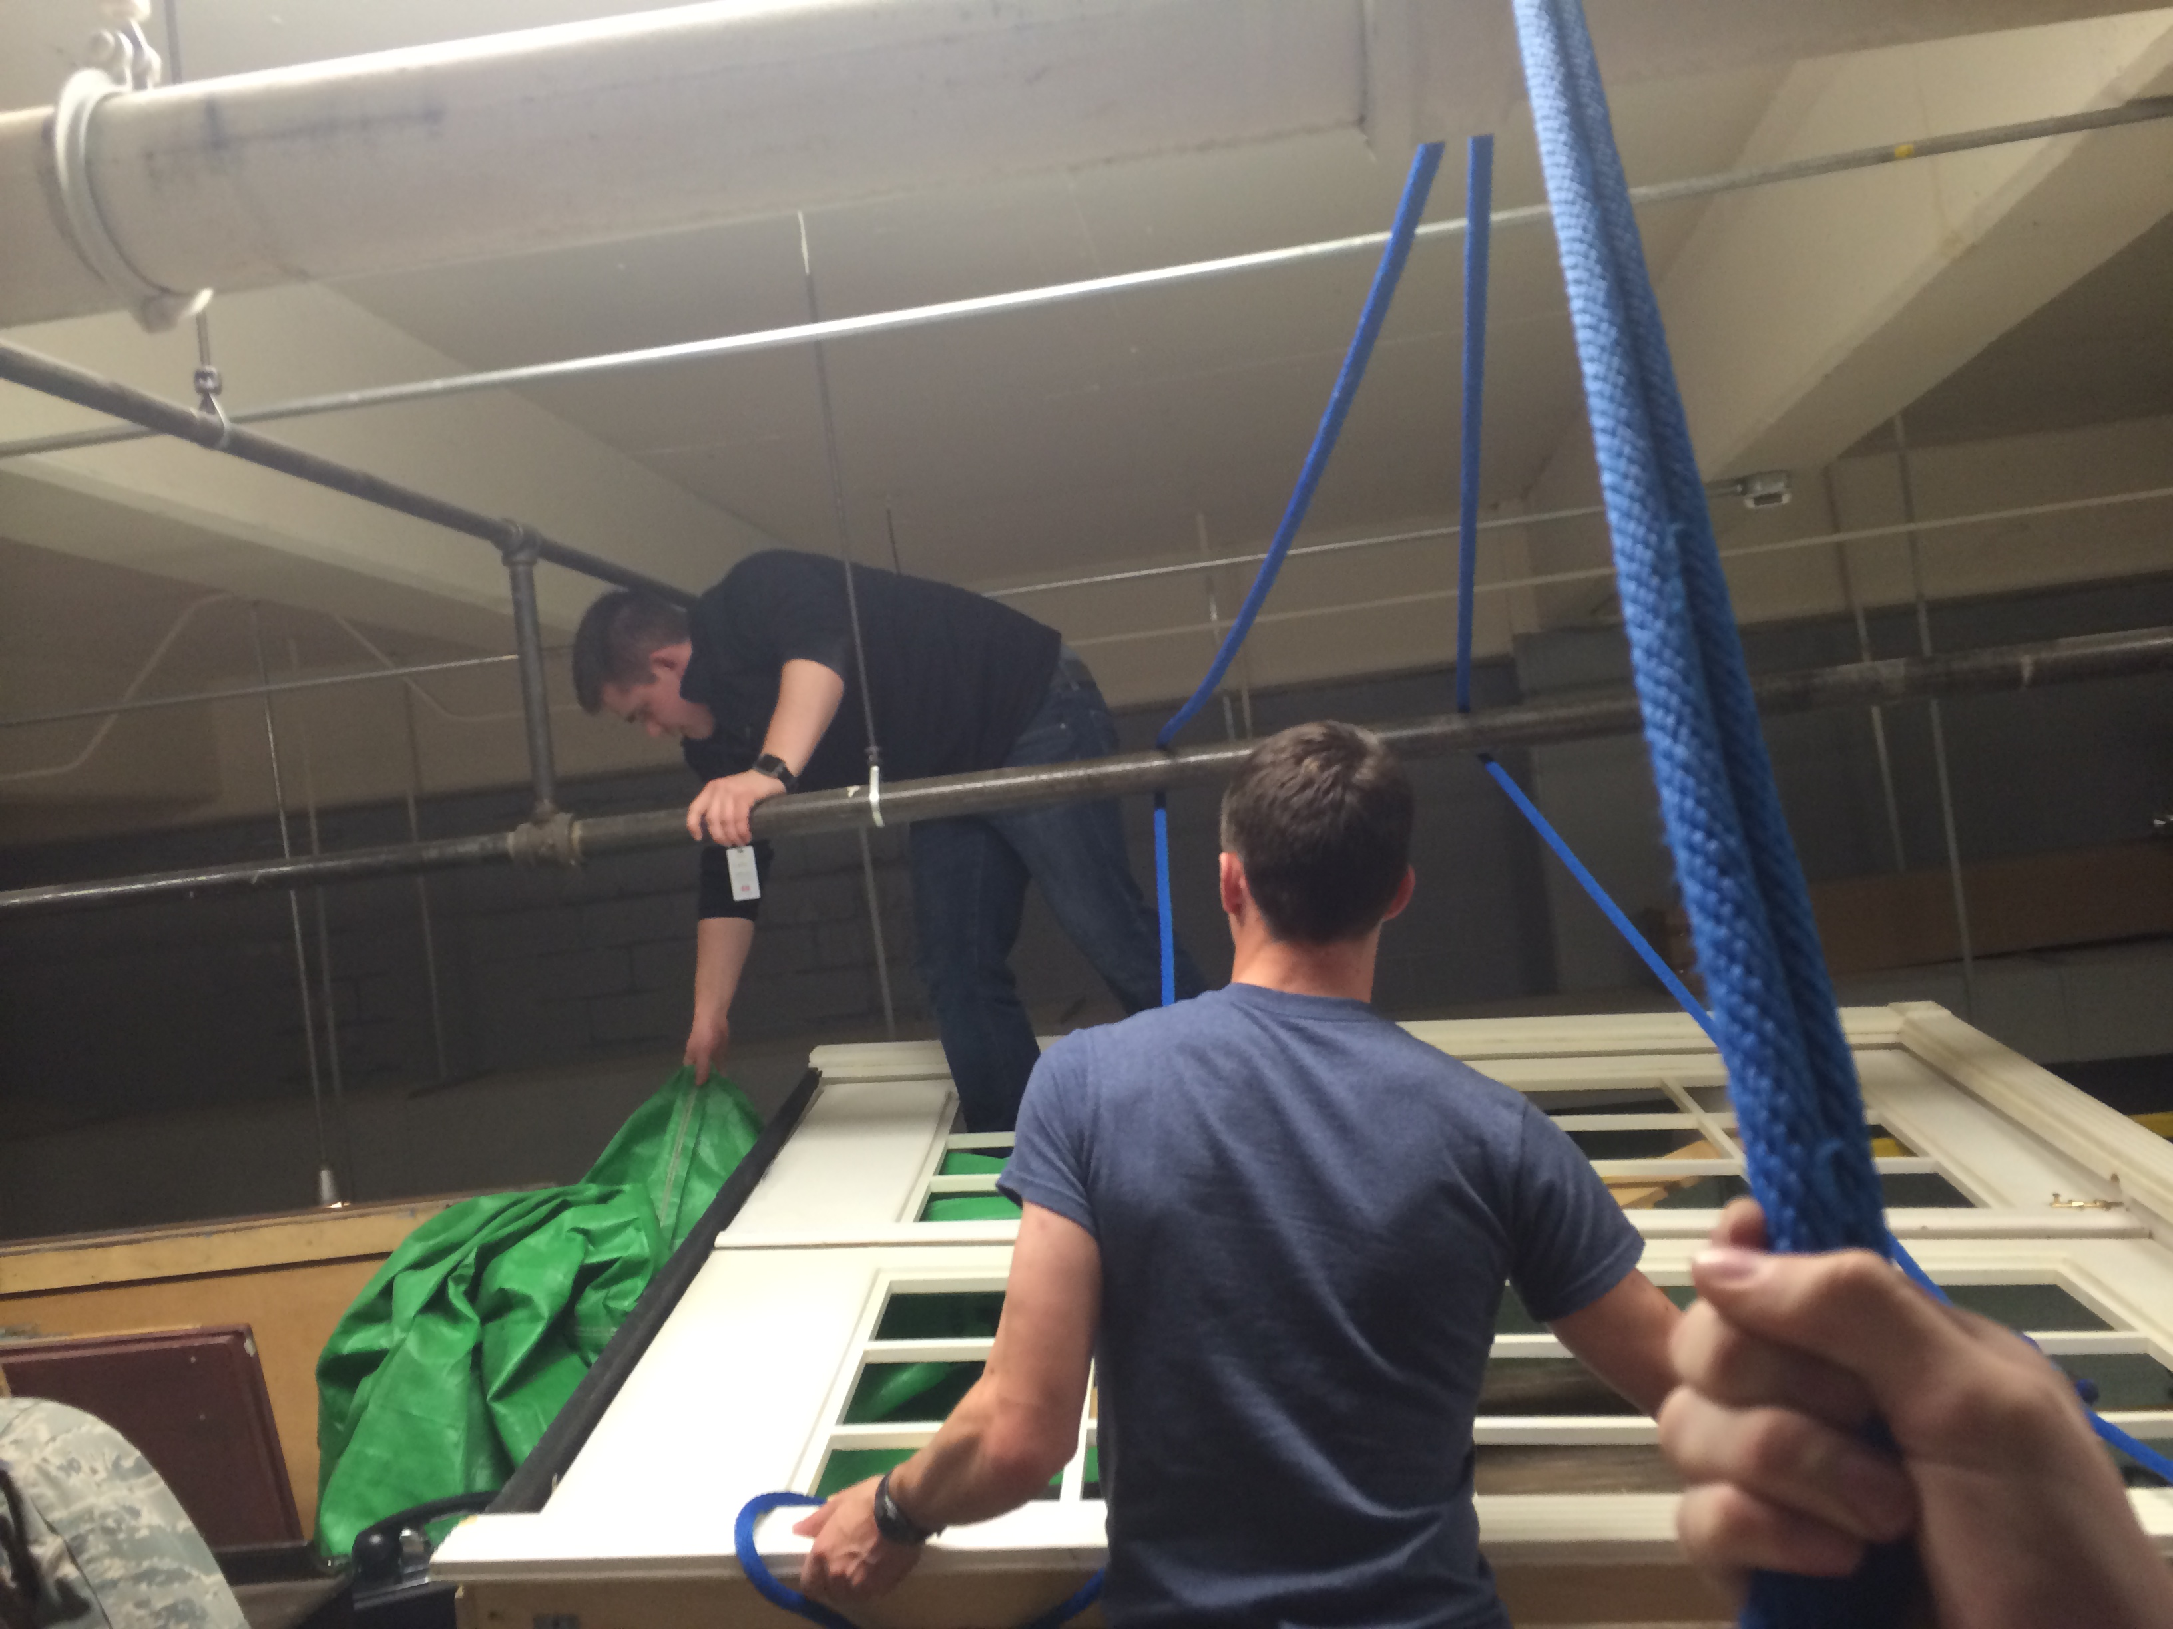
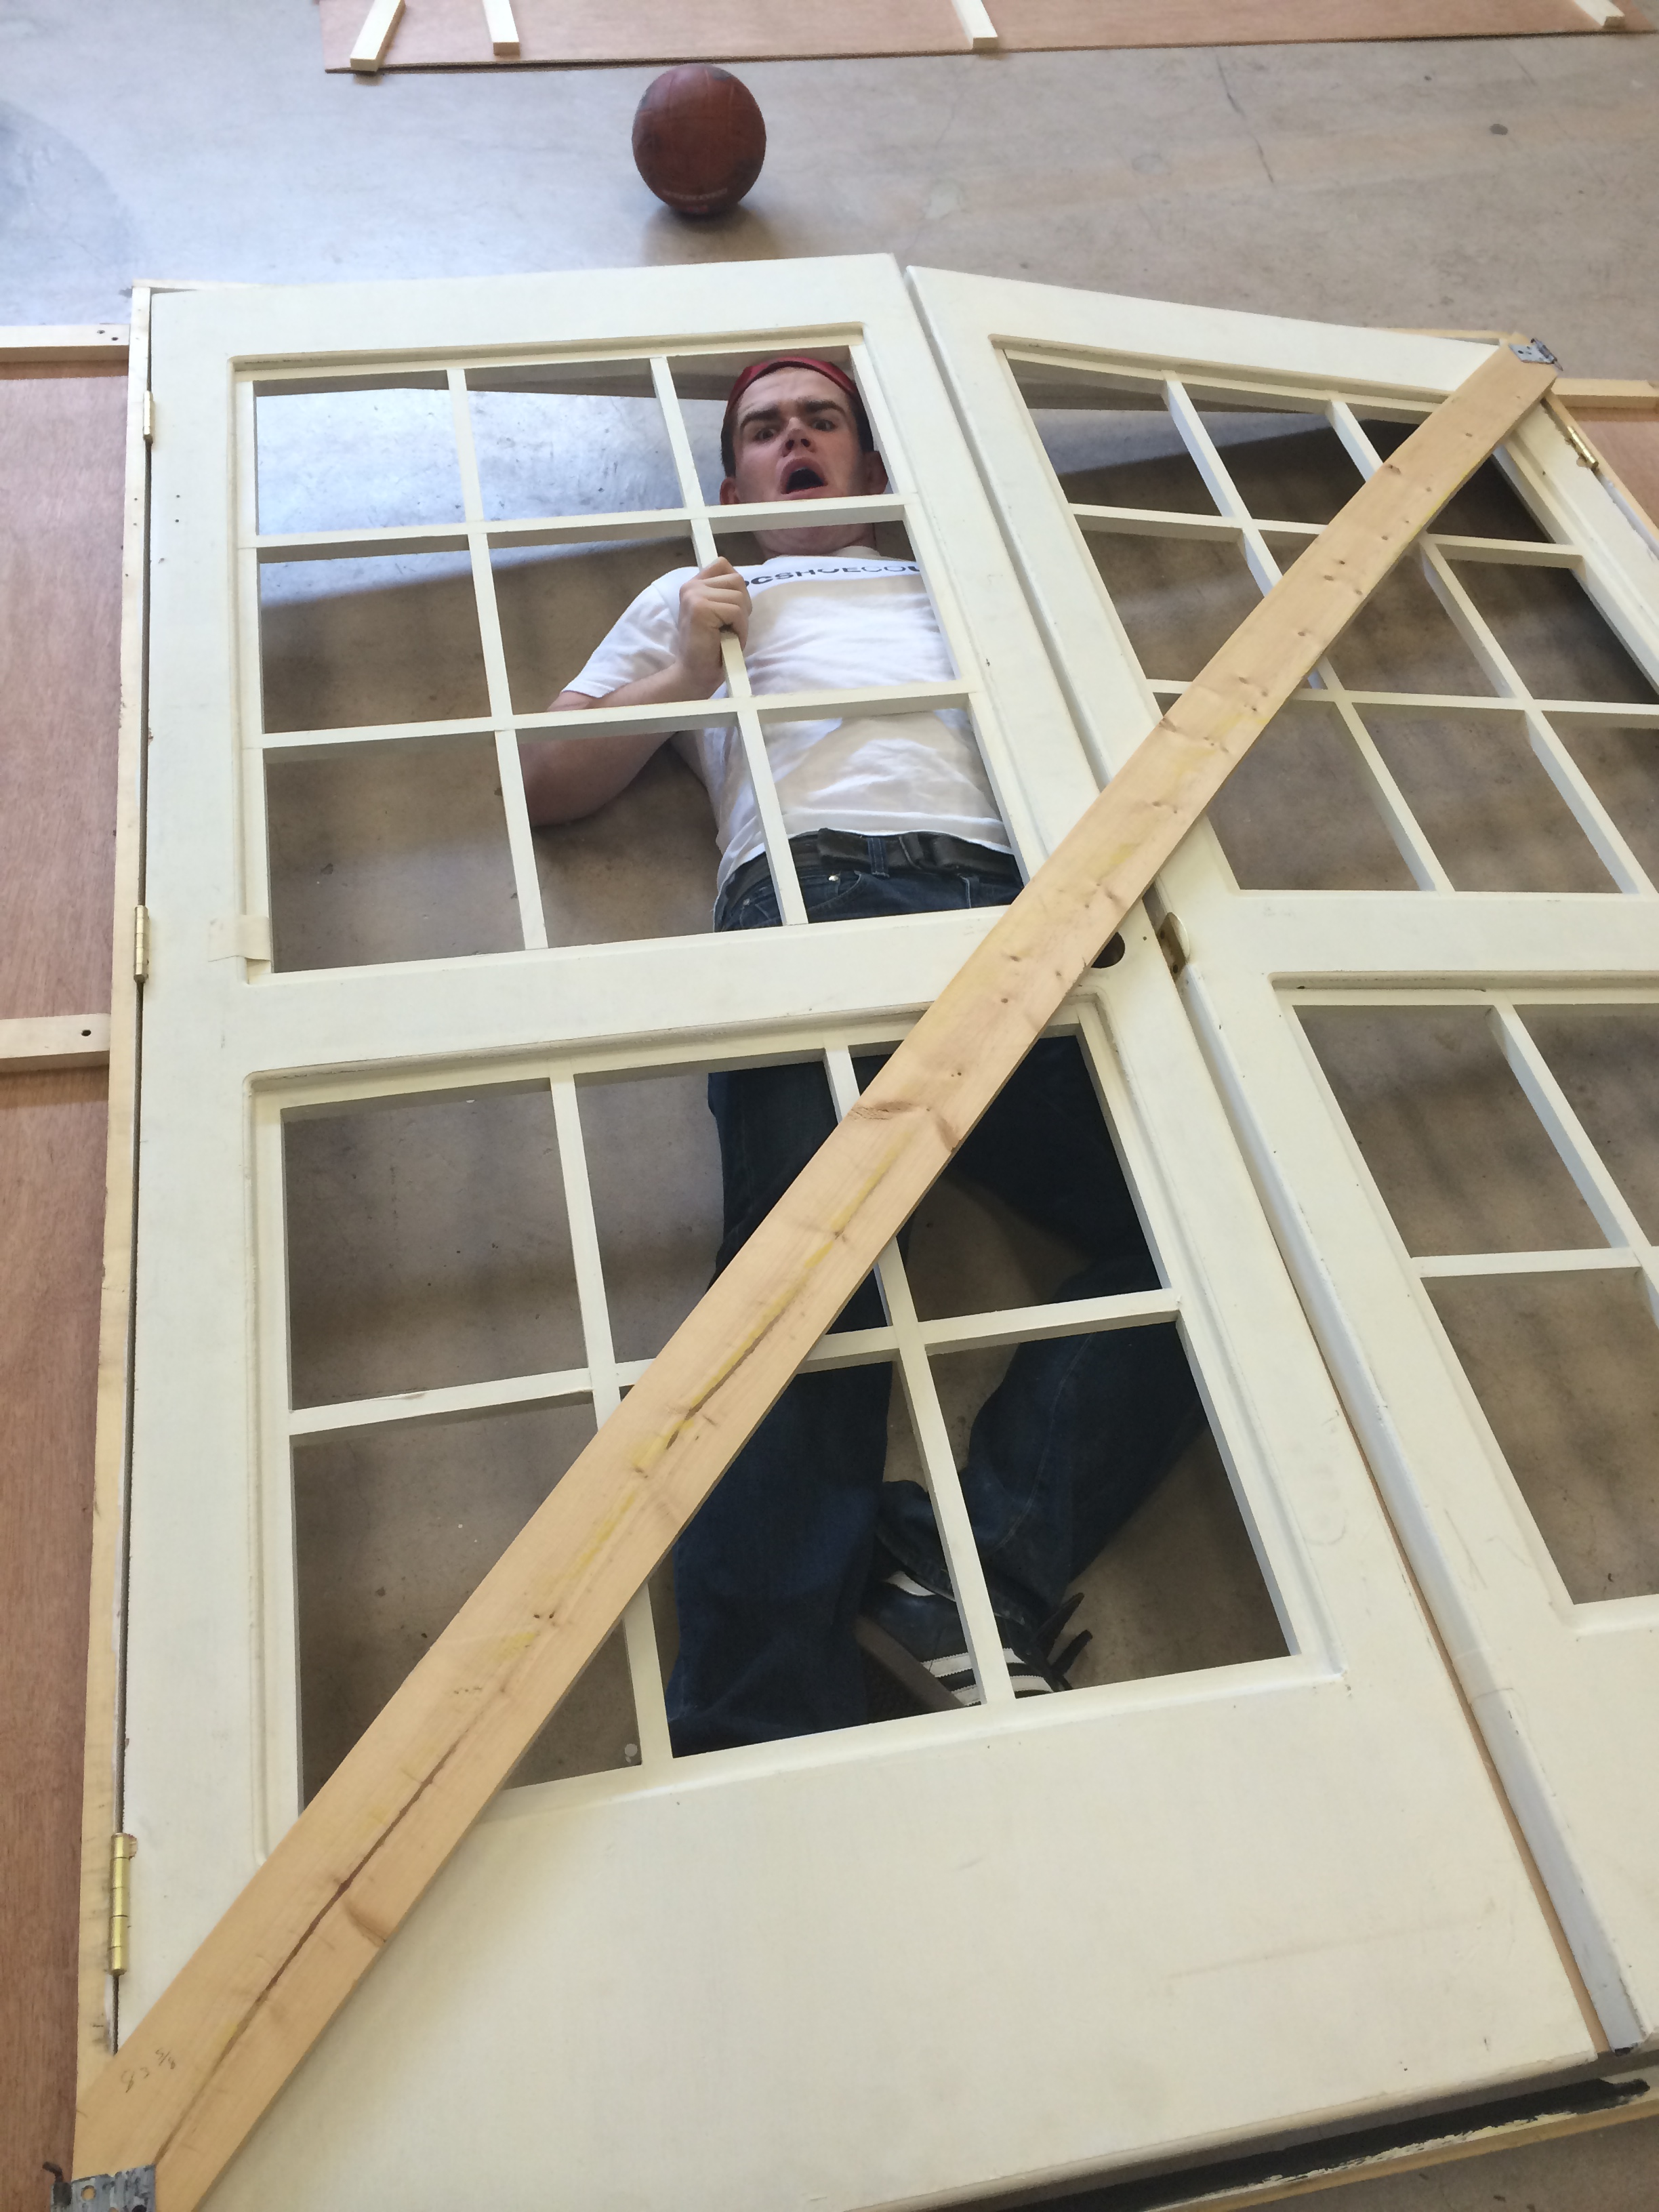
“A person who never made a mistake never tried anything new.”
-Albert Einstein

Slide 6
Safety
For Yourself
For Your Equipment
For Those Around You

Slide 7
Today’s Gameplan
The Arduino
Hardware
Software
Individual Design

Slide 8
The Arduino
Computer Science is no more about computers than astronomy is about telescopes.
-Edsger Dijkstra

Slide 9
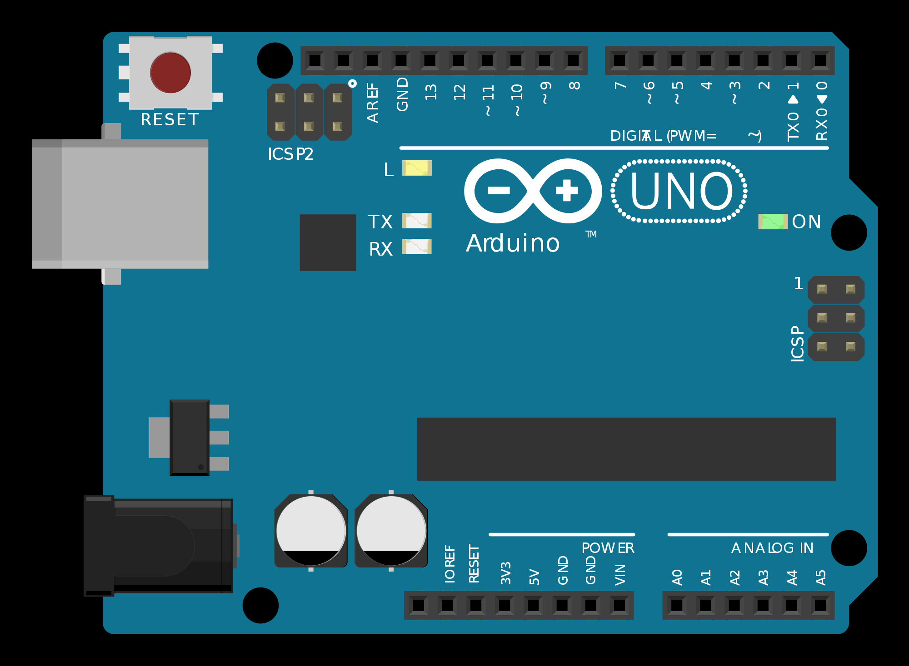
Notes:
Reset Button
USB Jack
Barrel Jack
Power Pins
Analog Pins
Digital Pins

Slide 10
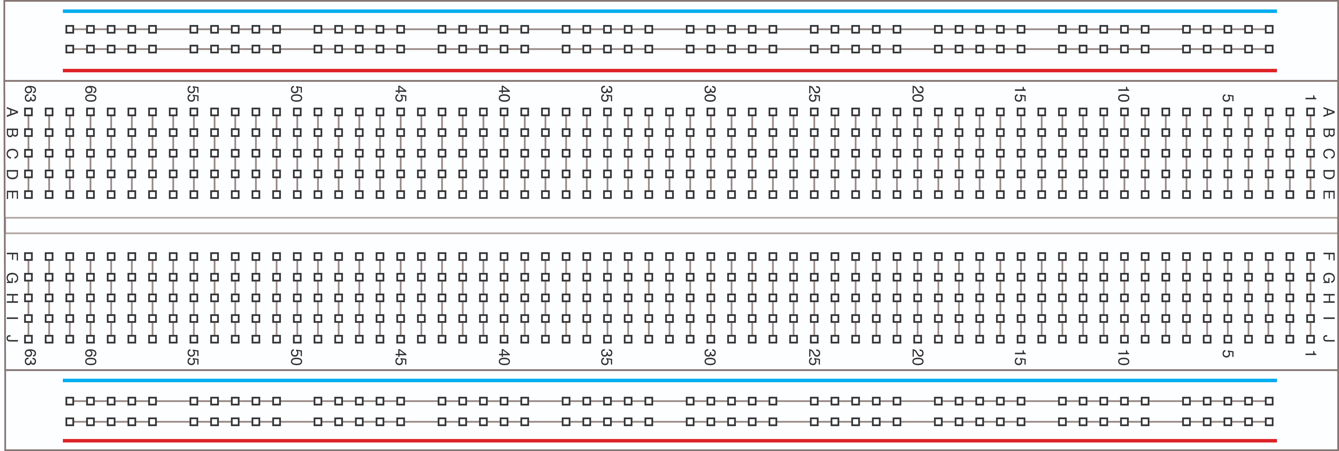
Notes:
Internal Connections

Slide 11
Hardware
Its hardware that makes a machine fast. Its software that makes a fast machine slow.
-Craig Bruce

Slide 12
Content in three columns
Content A
Content B
Content C
Content itself is what the end-user derives value from also can refer to the information provided through the medium,
Content itself is what the end-user derives value from also can refer to the information provided through the medium,
Content itself is what the end-user derives value from also can refer to the information provided through the medium,

Slide 13
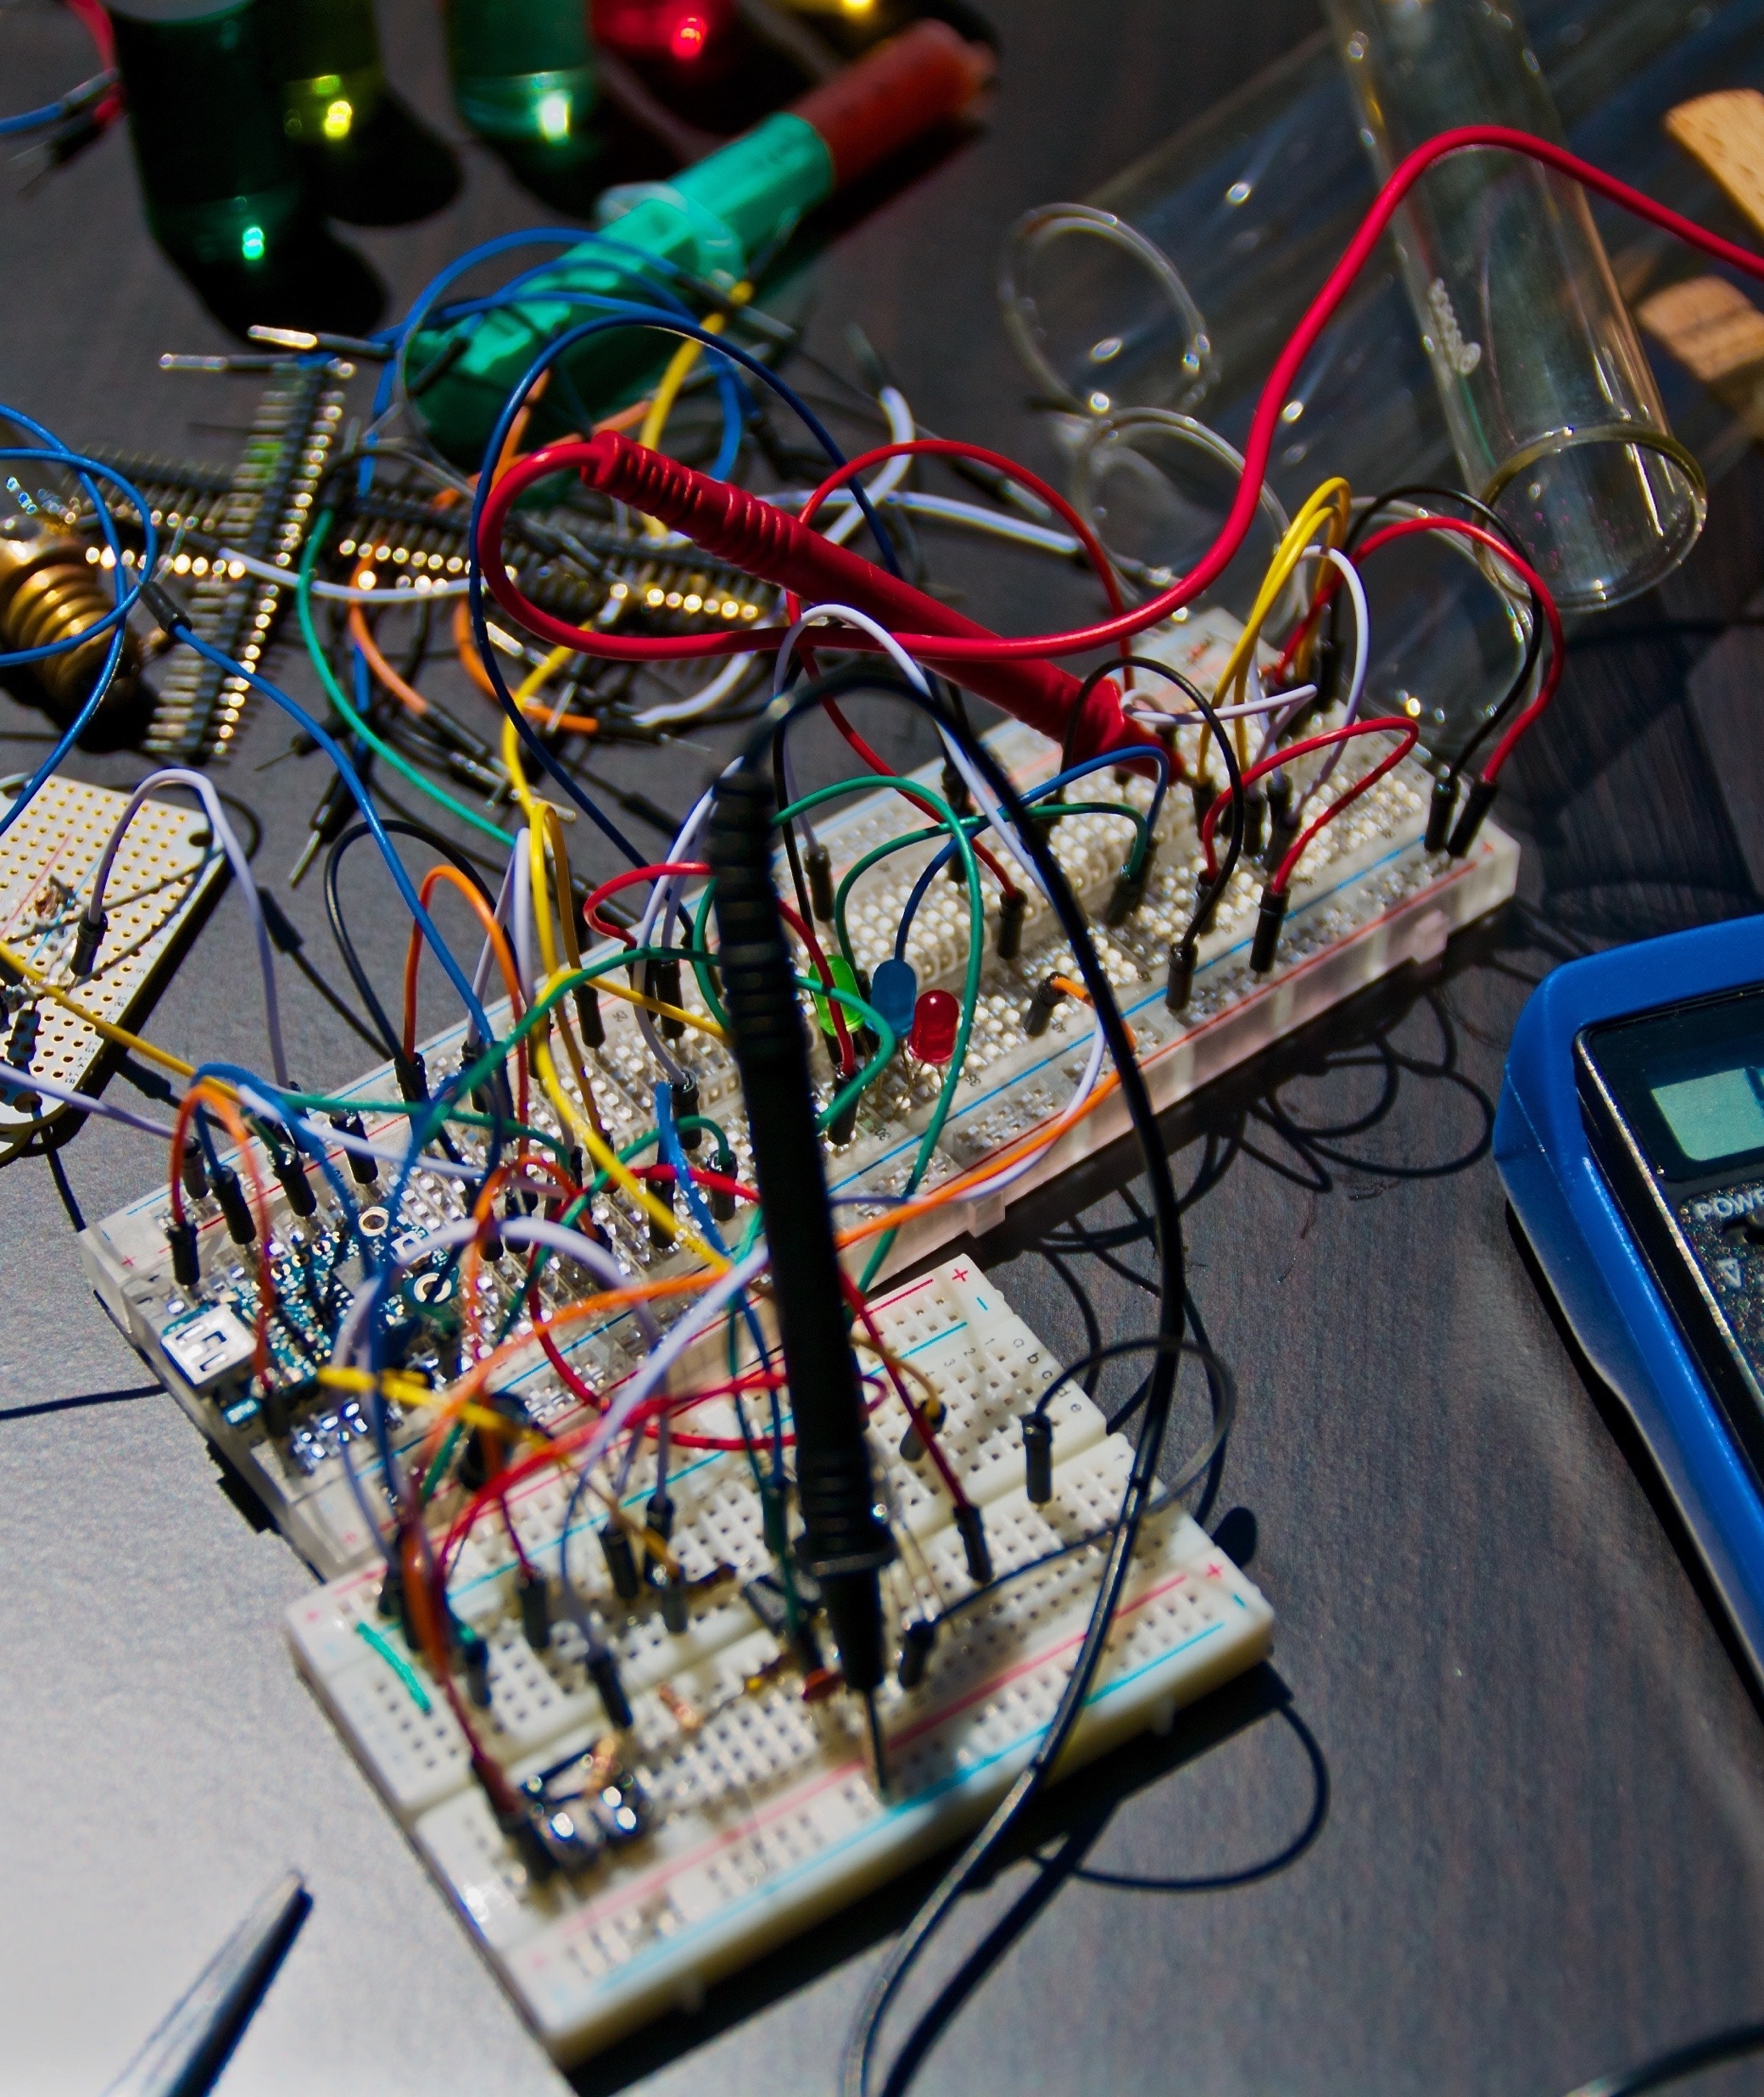
A Picture Is Worth A Thousand Words
Itself is what the end-user derives value from also.

Slide 14
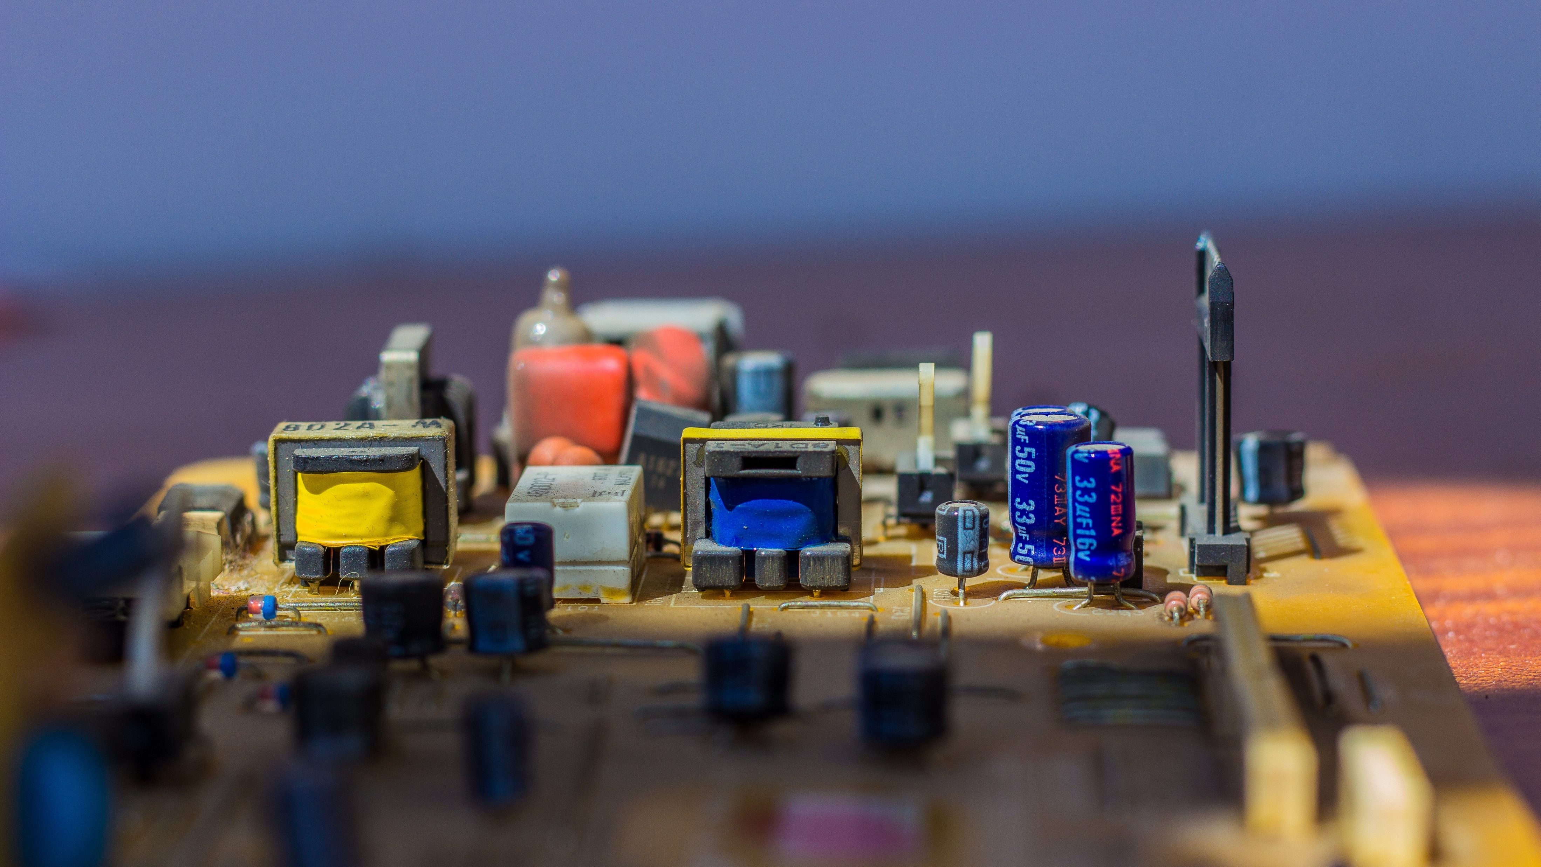
Use Big Images To Show Your Ideas

Slide 15
Shapes to explain ideas
Your Title
Your Title
Your Title
Write your description here
Write your description here
Write your description here
Your Title
Your Title
Write your description here
Write your description here

Slide 16
Features with icons
Service 01
Service 02
Service 03

Slide 17
Tables to compare data
 | A | B | C
Content A | 100 | 200 | 400
Content B | $67,000 | $56,000 | $78,000
Content C | 4500 | 60000 | $8,000

Slide 18
World Map
USA
19,450000
Europe
19,450000
Brasil
19,450000

Slide 19
56,790,500
Write here your big numbers

Slide 20
Funny Facts
56,790,500
130%
56,790,500
Revenue from sales
Project Achievements
Users around the world

Slide 21
The Process
Due to the fact that mobile lorem
Due to the fact that mobile lorem
OPTION
OPTION
OPTION
OPTION
OPTION
1
2
3
4
5
Due to the fact that mobile lorem
Due to the fact that mobile lorem
Due to the fact that mobile lorem

Slide 22
Features with icons
Content A
Content B
Content C
Itself is what the end-user derives value from also can refer to the information
Itself is what the end-user derives value from also can refer to the information
Itself is what the end-user derives value from also can refer to the information
Content D
Content E
Content F
Itself is what the end-user derives value from also can refer to the information
Itself is what the end-user derives value from also can refer to the information
Itself is what the end-user derives value from also can refer to the information

Slide 23
Use charts to present data
Your Title here
50%
Your Title here
50%
Your Title here
50%
Defined as a greater likelihood that users will share content posted to their social network many social media sites provide specific functionality

Slide 24

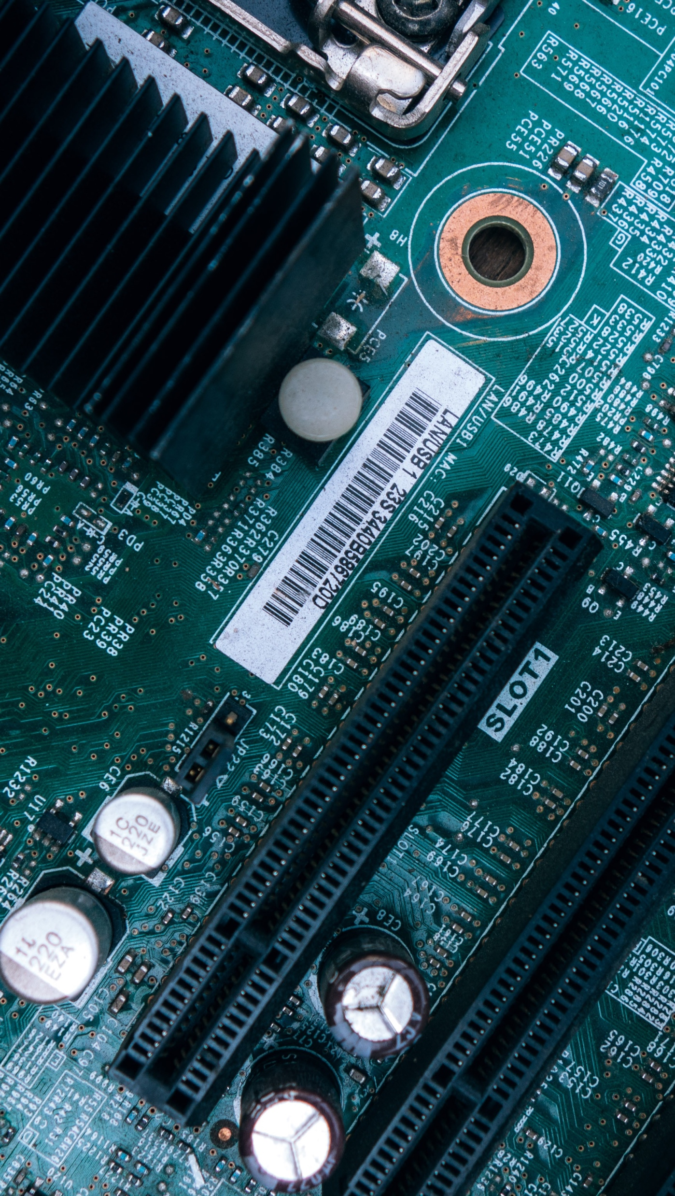
Mobile App
Itself is what the end-user derives value from also can refer is what.

Slide 25
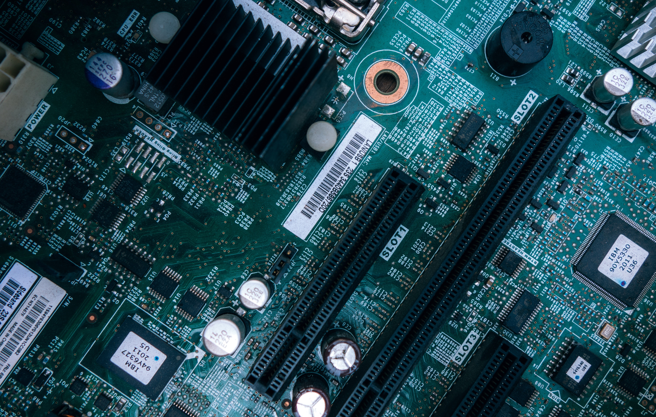
Laptop Project
Itself is what the end-user derives value from also can refer is what.

Slide 26
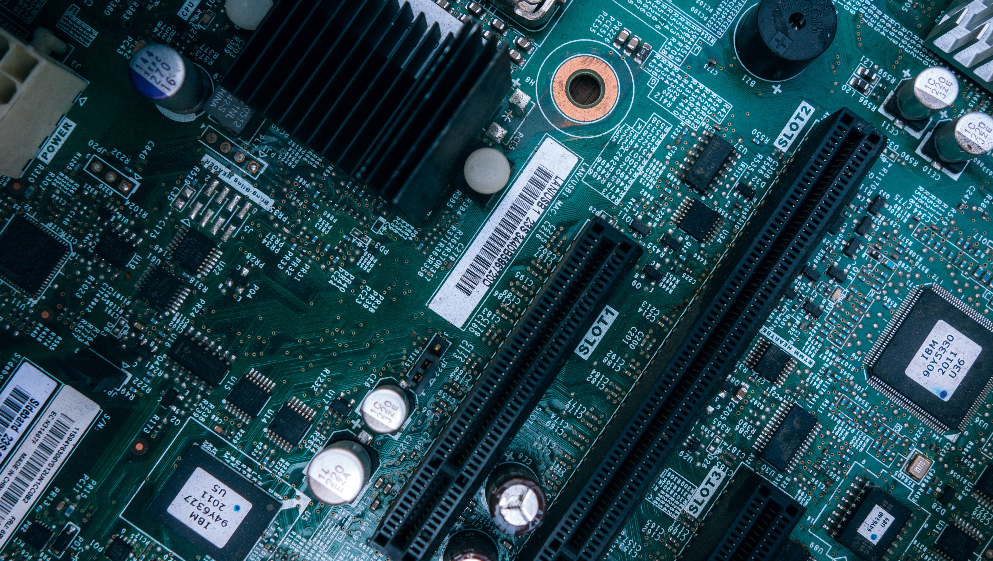
Desktop Project
Itself is what the end-user derives value from also can refer is what.

Slide 27
Thanks!
Any questions?
You can find me at: @username
myemail@domain.com

Slide 28
Credits
Special thanks to all people who made and shared these awesome resources for free:
Presentation template designed by powerpointify.com
Photographs by unsplash.com

Slide 29
Presentation design
This presentation uses the following typographies and colors:
Free Fonts used:
https://www.fontsquirrel.com/fonts/asap
Colors used:

